Slide 1
Spam detection classifier review
2012-10-24

Slide 2
Content
Assumption & Goal
Classifier Model & Process
Naive Bayesian Classifier
Fisher Classifier
Revised Classifier
Other Classifiers
Experiment result
Integration in SCP Moderation

Slide 3
Assumption & Goal

Slide 4
Assumptions
Some words are more likely to be in spam than in non-spam;
Words appear in spams in history will more likely to be in upcoming spams.
Trained on examples: The classifier will only based on you telling them what is spam and what isn’t.
Word probabilities within comments are independent.

Slide 5
Goal
Implement a content filter which can find out spam from sheer amount of comments based on content analysis.
By accumulating training historical data, the classifier will be able to have the knowledge of filtering future content.

Slide 6
Model & Process

Slide 7
Classifier Model
Features: Words in comment. anything determine as being either present/absent in the items.
Documents: Comments. Entity which hold features in and will be evaluated;
Category: Spam/Non-Spam classifier could have multiple categories, in Spam detection, we only have two;

Slide 8
Classifier Process
Spam
Non Spam
Feature extraction
Feature prob Calculation
Document prob Calculation
Life is
The main
Last key
Training
Classifying

Slide 9
Naïve Bayesian Classifier

Slide 10
Feature extraction
Break up the comment content into lowercased words by dividing the text by list of delimiters;
Feature selection considerations:
Only get first 10 lines;
Normalize before extraction;
Remove all special characters;
Other features like CAPITALIZED, continuous non characters words, headers, etc.
Remove stop words ( pros & cons )
“’ removal” + 3%.

Slide 11
Feature Probability calculation
Feature Probability:
The probability that a word is in a particular category;
Pr( feature|category ) =number of times the word appears in documents( comment ) of that category / the total number of documents in that category
Example: ( total spam: 90, total non-spam: 150) ‘lonely’ -> ( Spam: 27, Non-Spam:5 ), ‘at’ -> (Spam: 35, Non-Spam:35)
Pr(‘lonely’, Spam ) = 27 / 90 = 0.3

Slide 12
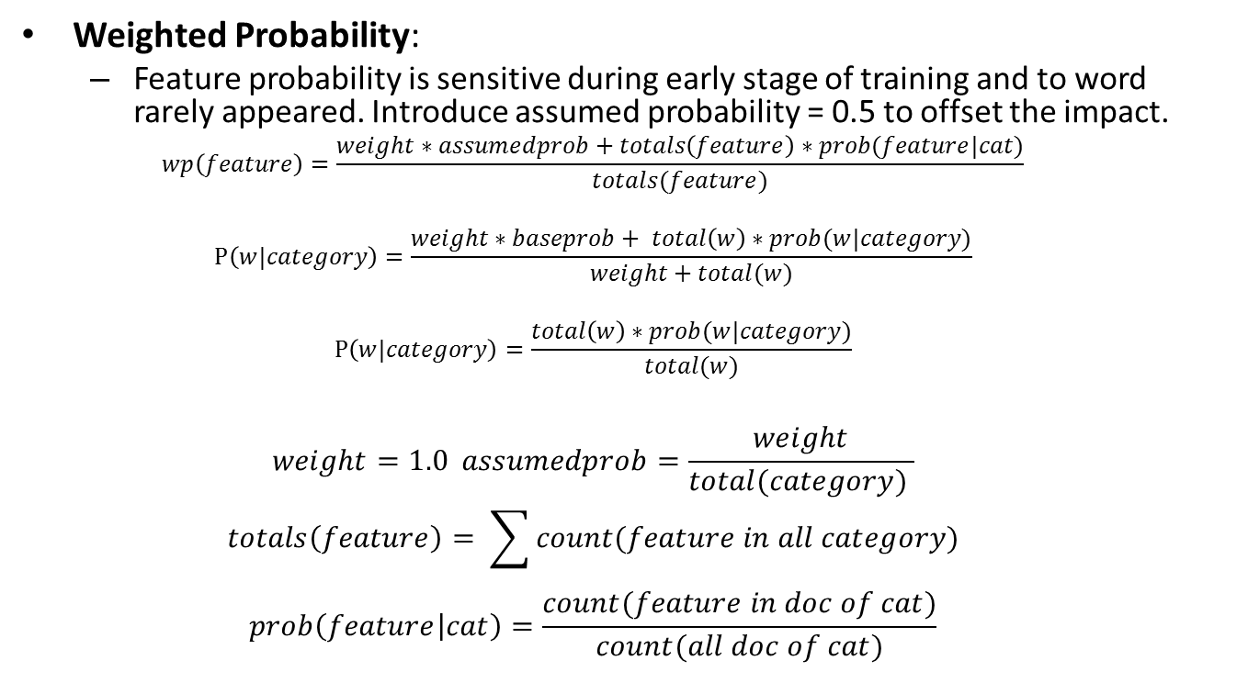
Feature Weighted Probability Calculation
Weighted Probability:
Feature probability is sensitive during early stage of training and to word rarely appeared. Introduce assumed probability = 0.5 to offset the impact.
$$wp\left(feature\right)=\frac{weight∗assumedprob+totals\left(feature\right)∗prob(feature|cat)}{totals(feature)}$$
$$P\left(w|category\right)=\frac{weight∗baseprob+ total\left(w\right)∗prob(w|category)}{weight+total(w)}$$
$$P\left(w|category\right)=\frac{total\left(w\right)∗prob(w|category)}{total(w)}$$
$$weight=1.0 assumedprob=\frac{weight}{total(category) }$$
$$totals\left(feature\right)= \sum{count(feature in all category)}$$
$$prob\left(feature | cat\right)=\frac{count(feature in doc of cat)}{count(all doc of cat)}$$

Slide 13
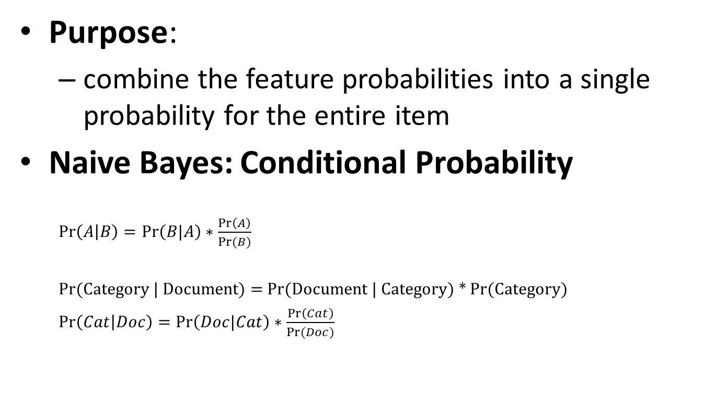
Document Probability Calculation
Purpose:
combine the feature probabilities into a single probability for the entire item
Naive Bayes: Conditional Probability
$\operatorname{Pr}\left(A | B\right)=\operatorname{Pr}\left(B|A\right)∗\frac{\operatorname{Pr}\left(A\right)}{Pr⁡(B)}$
Pr(Category | Document) = Pr(Document | Category) * Pr(Category)
$\operatorname{Pr}\left(Cat | Doc\right)=\operatorname{Pr}\left(Doc|Cat\right)∗\frac{\operatorname{Pr}\left(Cat\right)}{Pr⁡(Doc)}$

Slide 14
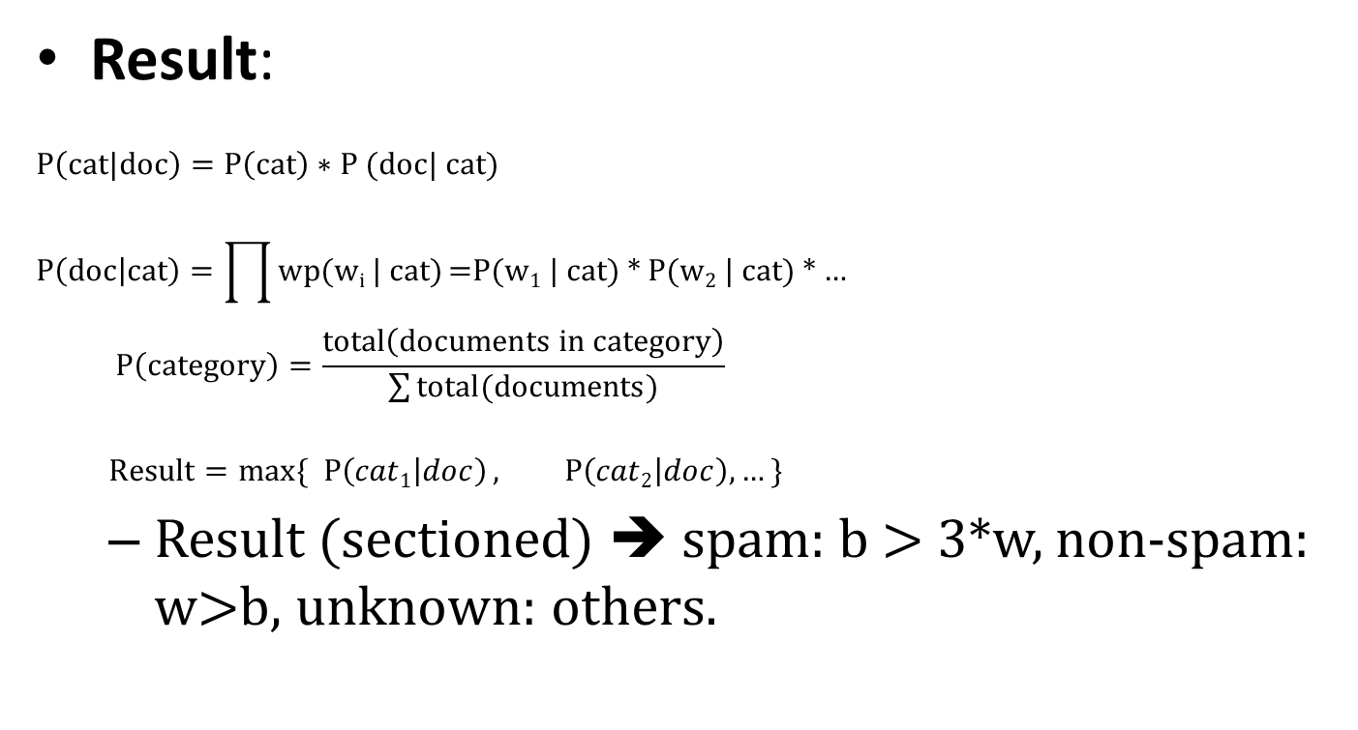
Document Probability Calculation
Result:
$$P\left(cat|doc\right)=P\left(cat\right)∗\text{P}\text{ (}\text{doc}\text{| }\text{cat}\text{)}$$
$$P\left(doc | cat\right)=\prod{wp(wi | cat)}\text{=}\text{P}\text{(}\text{w}\text{1}\text{ | }\text{cat}\text{) ∗ }\text{P}\text{(}\text{w}\text{2}\text{ | }\text{cat}\text{) ∗ …}$$
$$P\left(category\right)=\frac{total\left(documents in category\right)}{\sum{total(documents)}}$$
$$Result=max⁡\{P\left(cat1 | doc\right), P\left(cat2 | doc\right), …\}$$
Result (sectioned) ➔ spam: b > 3*w, non-spam: w>b, unknown: others.

Slide 15
Fisher Method Classifier

Slide 16

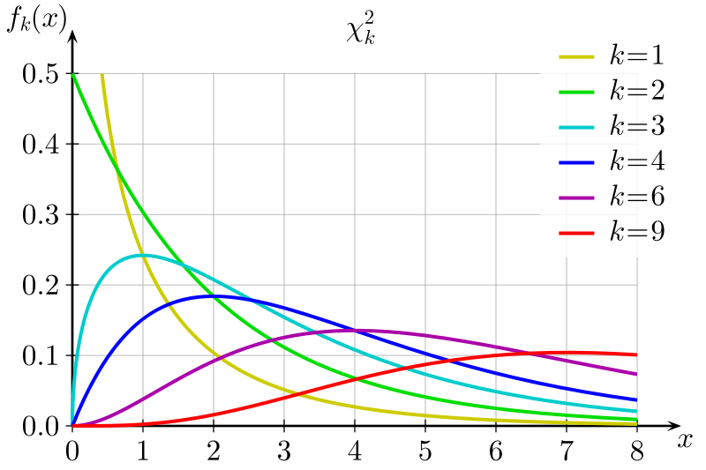

Assumption
if the feature probabilities were independent and random, the result of $−2∗\log\left(\operatorname{Pr}\left(cat | doc\right)\right)$would fit a chi-squared distribution.

Slide 17
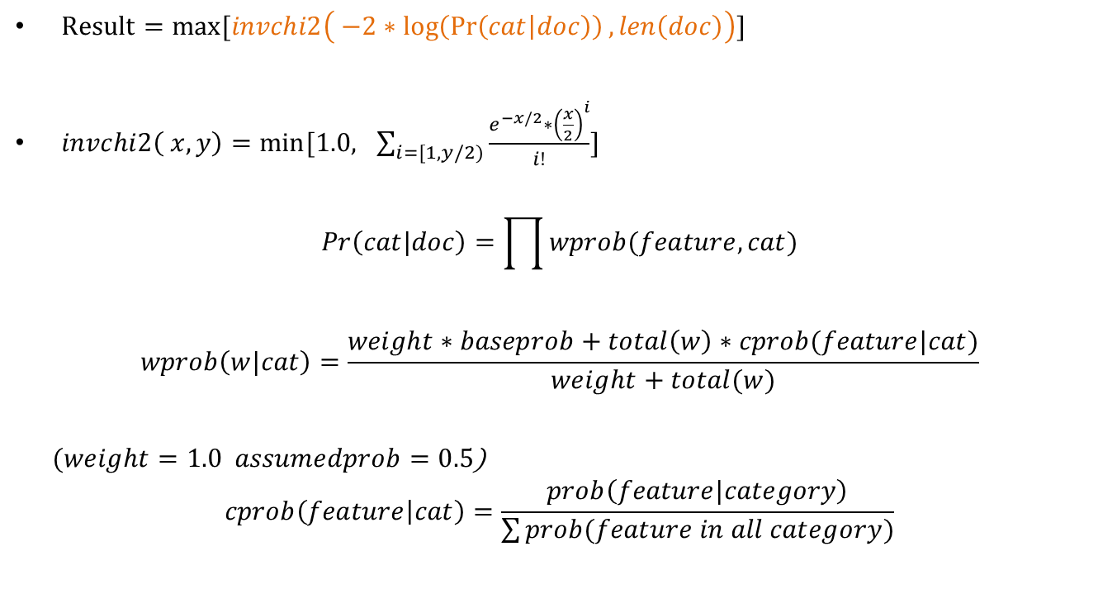
Major formulas
$Result=\max{[invchi2\left( −2∗\log\left(\operatorname{Pr}\left(cat | doc\right)\right),len\left(doc\right)\right)]}$
$invchi2\left( x, y\right)=min⁡[1.0, \sum_{i=[1,y/2)}{\frac{e^{−x/2}∗{\left(\frac{x}{2}\right)}^{i}}{i!}}]$
$$Pr\left(cat|doc\right)=\prod{wprob(feature, cat)}$$
$$wprob\left(w|cat\right)=\frac{weight∗baseprob+total\left(w\right)∗cprob(feature|cat)}{weight+total(w)}$$
$(weight=1.0 assumedprob=0.5$)
$$cprob\left(feature | cat\right)=\frac{prob\left(feature|category\right)}{\sum{prob(feature in all category)}}$$

Slide 18
Revised Bayesian Classifier

Slide 19
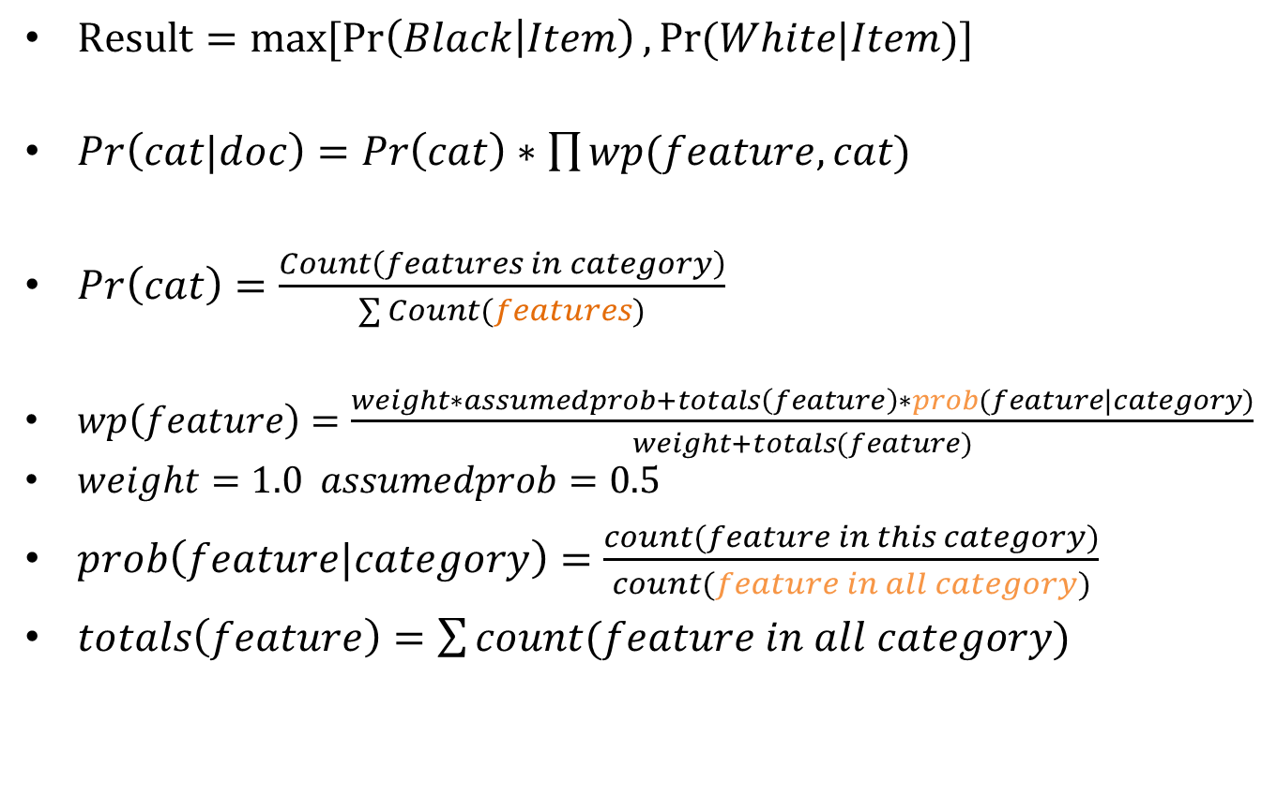
Major Formula
$Result=max⁡[\operatorname{Pr}\left(Black | Item\right),Pr⁡(White|Item)]$
$Pr\left(cat|doc\right)=Pr\left(cat\right)∗\prod{wp(feature, cat)}$
$Pr\left(cat\right)=\frac{Count\left(features in category\right)}{\sum{Count(features)}}$
$wp\left(feature\right)=\frac{weight∗assumedprob+totals\left(feature\right)∗prob(feature|category)}{weight+totals(feature)}$
$weight=1.0 assumedprob=0.5$
$prob\left(feature|category\right)=\frac{count(feature in this category)}{count(feature in all category)}$
$totals\left(feature\right)=\sum{count(feature in all category)}$

Slide 20
Other Classifiers
Akismet
Bayesian Net
Neural Network
SVM
Decision Tree

Slide 21
comparison
Speed +
Incremental training +
Simplicity of model interpretation +
Inability to deal with change of feature combination –

Slide 22
Experimentation & result

Slide 23
Sample Train Data
@GOOD
Nobody owns the water.
The quick rabbit jumps fences.
The quick brown fox jumps.
@END
@SPAM
Buy pharmaceuticals now!
Make quick money at the online casino
@END
Deal with Black words:10
Deal with White words:14
Black Prob:41.67%
White Prob:58.33%
Black features:10
White features:10
All features:18

Slide 24
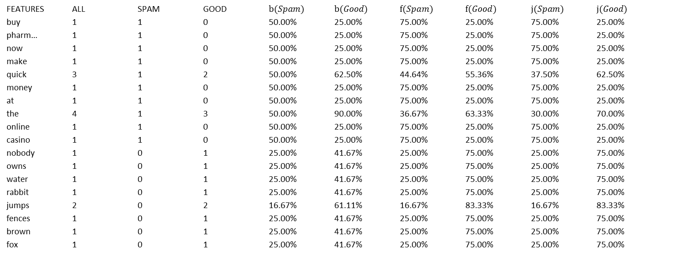
Sample Weighted Probability
FEATURES ALL SPAM GOOD $b(Spam)$ $b(Good)$ $f(Spam)$ $f(Good)$ $j(Spam)$ $j(Good)$
buy 1 1 0 50.00% 25.00% 75.00% 25.00% 75.00% 25.00%
pharm… 1 1 0 50.00% 25.00% 75.00% 25.00% 75.00% 25.00%
now 1 1 0 50.00% 25.00% 75.00% 25.00% 75.00% 25.00%
make 1 1 0 50.00% 25.00% 75.00% 25.00% 75.00% 25.00%
quick 3 1 2 50.00% 62.50% 44.64% 55.36% 37.50% 62.50%
money 1 1 0 50.00% 25.00% 75.00% 25.00% 75.00% 25.00%
at 1 1 0 50.00% 25.00% 75.00% 25.00% 75.00% 25.00%
the 4 1 3 50.00% 90.00% 36.67% 63.33% 30.00% 70.00%
online 1 1 0 50.00% 25.00% 75.00% 25.00% 75.00% 25.00%
casino 1 1 0 50.00% 25.00% 75.00% 25.00% 75.00% 25.00%
nobody 1 0 1 25.00% 41.67% 25.00% 75.00% 25.00% 75.00%
owns 1 0 1 25.00% 41.67% 25.00% 75.00% 25.00% 75.00%
water 1 0 1 25.00% 41.67% 25.00% 75.00% 25.00% 75.00%
rabbit 1 0 1 25.00% 41.67% 25.00% 75.00% 25.00% 75.00%
jumps 2 0 2 16.67% 61.11% 16.67% 83.33% 16.67% 83.33%
fences 1 0 1 25.00% 41.67% 25.00% 75.00% 25.00% 75.00%
brown 1 0 1 25.00% 41.67% 25.00% 75.00% 25.00% 75.00%
fox 1 0 1 25.00% 41.67% 25.00% 75.00% 25.00% 75.00%

Slide 25
Sample Result
“quick rabbit”
Black Probability = 0.050000
White Probability = 0.156250
(Naïve Bayes method)
Black Probability = 0.35633596283335256
White Probability = 0.78013986588957995
(Fisher method)
Black Probability = 0.0390625
White Probability = 0.2734375
(Revised Bayesian method)

Slide 26
Precision & Recall
In Text classification area:
Precision = detected true positive(negative) items/detected positive(negative) items;
Recall = detected true positive(negative) items / true positive(negative) items in sample data.
Samples
----------------------------------------
M\C Black White Total Rate
Black 1212 266 1478 R(B)=82.00%
White 677 8488 9165 R(W)=92.61%
Total 1889 8754 10643
Rate P(B)=64.16% P(W)=96.96% P(ALL)=91.14%
----------------------------------------

Slide 27
Naïve Bayes Method
Black Items:5000
White Items:5000
Man\Com Black White Total Recall
Black 1262 216 1478 85.39%
White 2142 7023 9165 76.63%
Total 3404 7239 10643
Prec 37.07% 97.02% 77.84%
Black Items:2000
White Items:5000
Man\Com Black White Total Recall
Black 1218 260 1478 82.41%
White 988 8177 9165 89.22%
Total 2206 8437 10643
Prec 55.21% 96.92% 88.27%
M = Man , C = Classifier
Black Items:5000
White Items:2000
Man\Com Black White Total Recall
Black 1320 158 1478 89.31%
White 3725 5440 9165 59.36%
Total 5045 5598 10643
Prec 26.16% 97.18% 63.52%
Black Items:1000
White Items:5000
Man\Com Black White Total Recall
Black 1194 284 1478 80.78%
White 632 8533 9165 93.10%
Total 1826 8817 10643
Prec 65.39% 96.78% 91.39%

Slide 28
Fisher Method
Black Items:5000
White Items:5000
Man\Com Black White Total Recall
Black 431 1047 1478 29.16%
White 256 8909 9165 97.21%
Total 687 9956 10643
Prec 62.74% 89.48% 87.76%
Black Items:2000
White Items:5000
Man\Com Black White Total Recall
Black 260 1218 1478 17.59%
White 160 9005 9165 98.25%
Total 420 10223 10643
Prec 61.90% 88.09% 87.05%
M = Man , C = Classifier
Black Items:5000
White Items:2000
Man\Com Black White Total Recall
Black 435 1043 1478 29.43%
White 303 8862 9165 96.69%
Total 738 9905 10643
Prec 58.94% 89.47% 87.35%
Black Items:2000
White Items:2000
Man\Com Black White Total Recall
Black 261 1217 1478 17.66%
White 176 8989 9165 98.08%
Total 437 10206 10643
Prec 59.73% 88.08% 86.91%

Slide 29
Revised Bayesian Method
Black Items:5000
White Items:5000
Man\Com Black White Total Recall
Black 1212 266 1478 82.00%
White 677 8488 9165 92.61%
Total 1889 8754 10643
Prec 64.16% 96.96% 91.14%
Black Items:2000
White Items:5000
Man\Com Black White Total Recall
Black 1080 398 1478 73.07%
White 27 9138 9165 99.71%
Total 1107 9536 10643
Prec 97.56% 95.83% 96.01%
M = Man , C = Classifier
Black Items:5000
White Items:2000
Man\Com Black White Total Recall
Black 1454 24 1478 98.38%
White 8507 658 9165 7.18%
Total 9961 682 10643
Prec 14.60% 96.48% 19.84%
Black Items:1000
White Items:5000
Man\Com Black White Total Recall
Black 924 554 1478 62.52%
White 6 9159 9165 99.93%
Total 930 9713 10643
Prec 99.35% 94.30% 94.74%

Slide 30
Integration in SCP Moderation

Slide 31
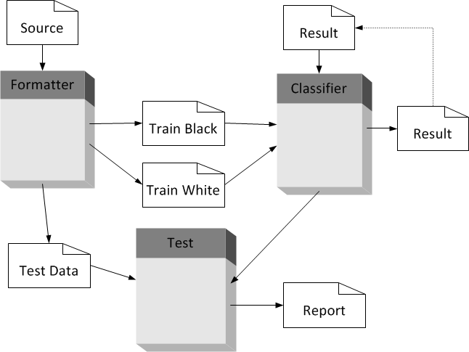
Classifier process

Slide 32
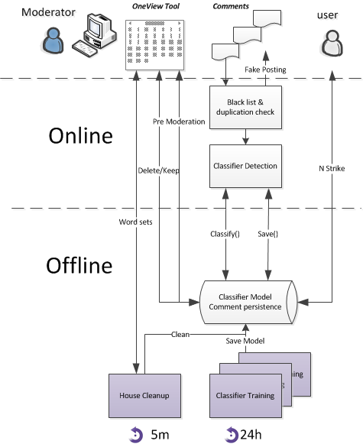
SCP Moderation integration

Slide 33
Q&A

